Slide 1



YOUNG PEOPLE ACCESSING ADVICE
This resource is part of the Ask Us Advice Toolkit. For more information or queries on any of the topics covered in this toolkit, or to find out about training and consultancy the Ask Us partners can offer please contact enquiries@1625ip.co.uk.
This resource was funded by The National Lottery Community Fund and is offered free for information, educational and professional development purposes. You may not sell this work, nor may it be used as supporting content for any commercial product or service. All copies of this work must clearly display the original copyright notice and Ask Us Toolkit website address. Any on-line reproduction must also provide a link to the Ask Us Toolkit website. Copyright© 2021. Ask Us is a 1625 Independent People, Citizen Advice Bristol and Bristol Law Centre project.
www.askustoolkit.co.uk

Slide 2
YOUNG PEOPLE ACCESSING ADVICE
Session Aims
Have gained knowledge and understanding of using a whole person approach to advice work
Understand how a young person’s brain develops.
Be able to put in practice key principles of trauma aware practice and why this method can reduce barriers to young people engaging with the advice process
Have knowledge of young person services and what their role is.
Copyright© 2021. Ask Us is a 1625 Independent People, Citizen Advice Bristol and Bristol Law Centre project

Slide 3



YOUNG PEOPLE ACCESSING ADVICE
Copyright© 2021. Ask Us is a 1625 Independent People, Citizen Advice Bristol and Bristol Law Centre project

Slide 4

YOUNG PEOPLE ACCESSING ADVICE
The Whole Person Approach
‘Start with the person, not the law’
Copyright© 2021. Ask Us is a 1625 Independent People, Citizen Advice Bristol and Bristol Law Centre project

Slide 5
YOUNG PEOPLE ACCESSING ADVICE
Handout of strengths based questions for session
What is working well?
Can you think of things you have done to help things go well?
What have you tried? And what has been helpful?
On a scale of 1 to 10 how would you say X is? What might make that score a little better?
What could be going better?
What stops things working better for you?
Copyright© 2021. Ask Us is a 1625 Independent People, Citizen Advice Bristol and Bristol Law Centre project

Slide 6
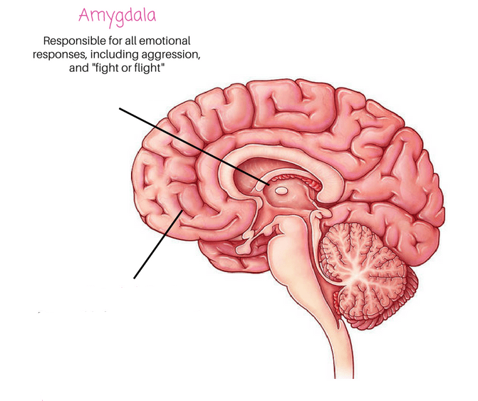
YOUNG PEOPLE ACCESSING ADVICE
How a young person’s brain works
Copyright© 2021. Ask Us is a 1625 Independent People, Citizen Advice Bristol and Bristol Law Centre project

Slide 7
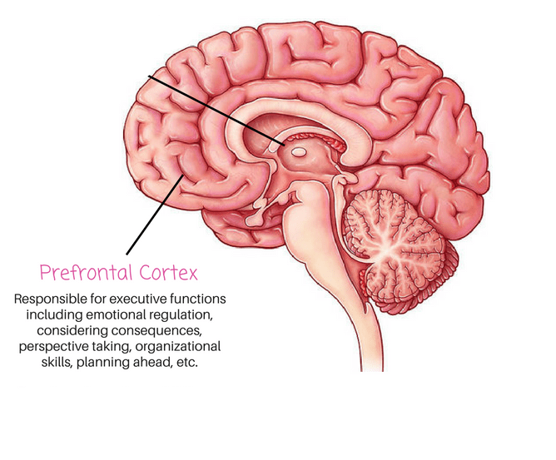
YOUNG PEOPLE ACCESSING ADVICE
The Prefrontal Cortex
Copyright© 2021. Ask Us is a 1625 Independent People, Citizen Advice Bristol and Bristol Law Centre project

Slide 8
YOUNG PEOPLE ACCESSING ADVICE
What things in our current advice approach creates barriers for young people?
Copyright© 2021. Ask Us is a 1625 Independent People, Citizen Advice Bristol and Bristol Law Centre project

Slide 9
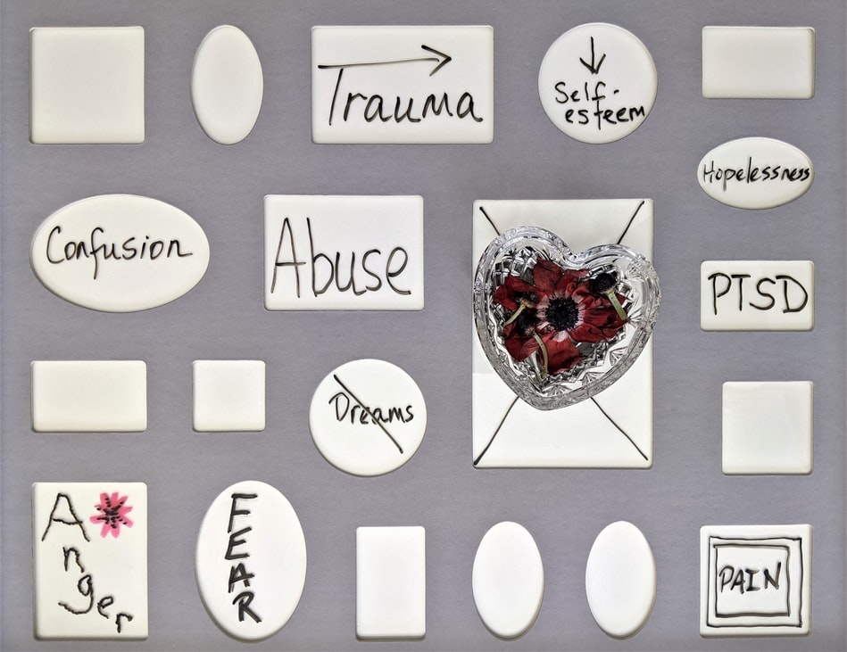
YOUNG PEOPLE ACCESSING ADVICE
Trauma aware
Copyright© 2021. Ask Us is a 1625 Independent People, Citizen Advice Bristol and Bristol Law Centre project

Slide 10
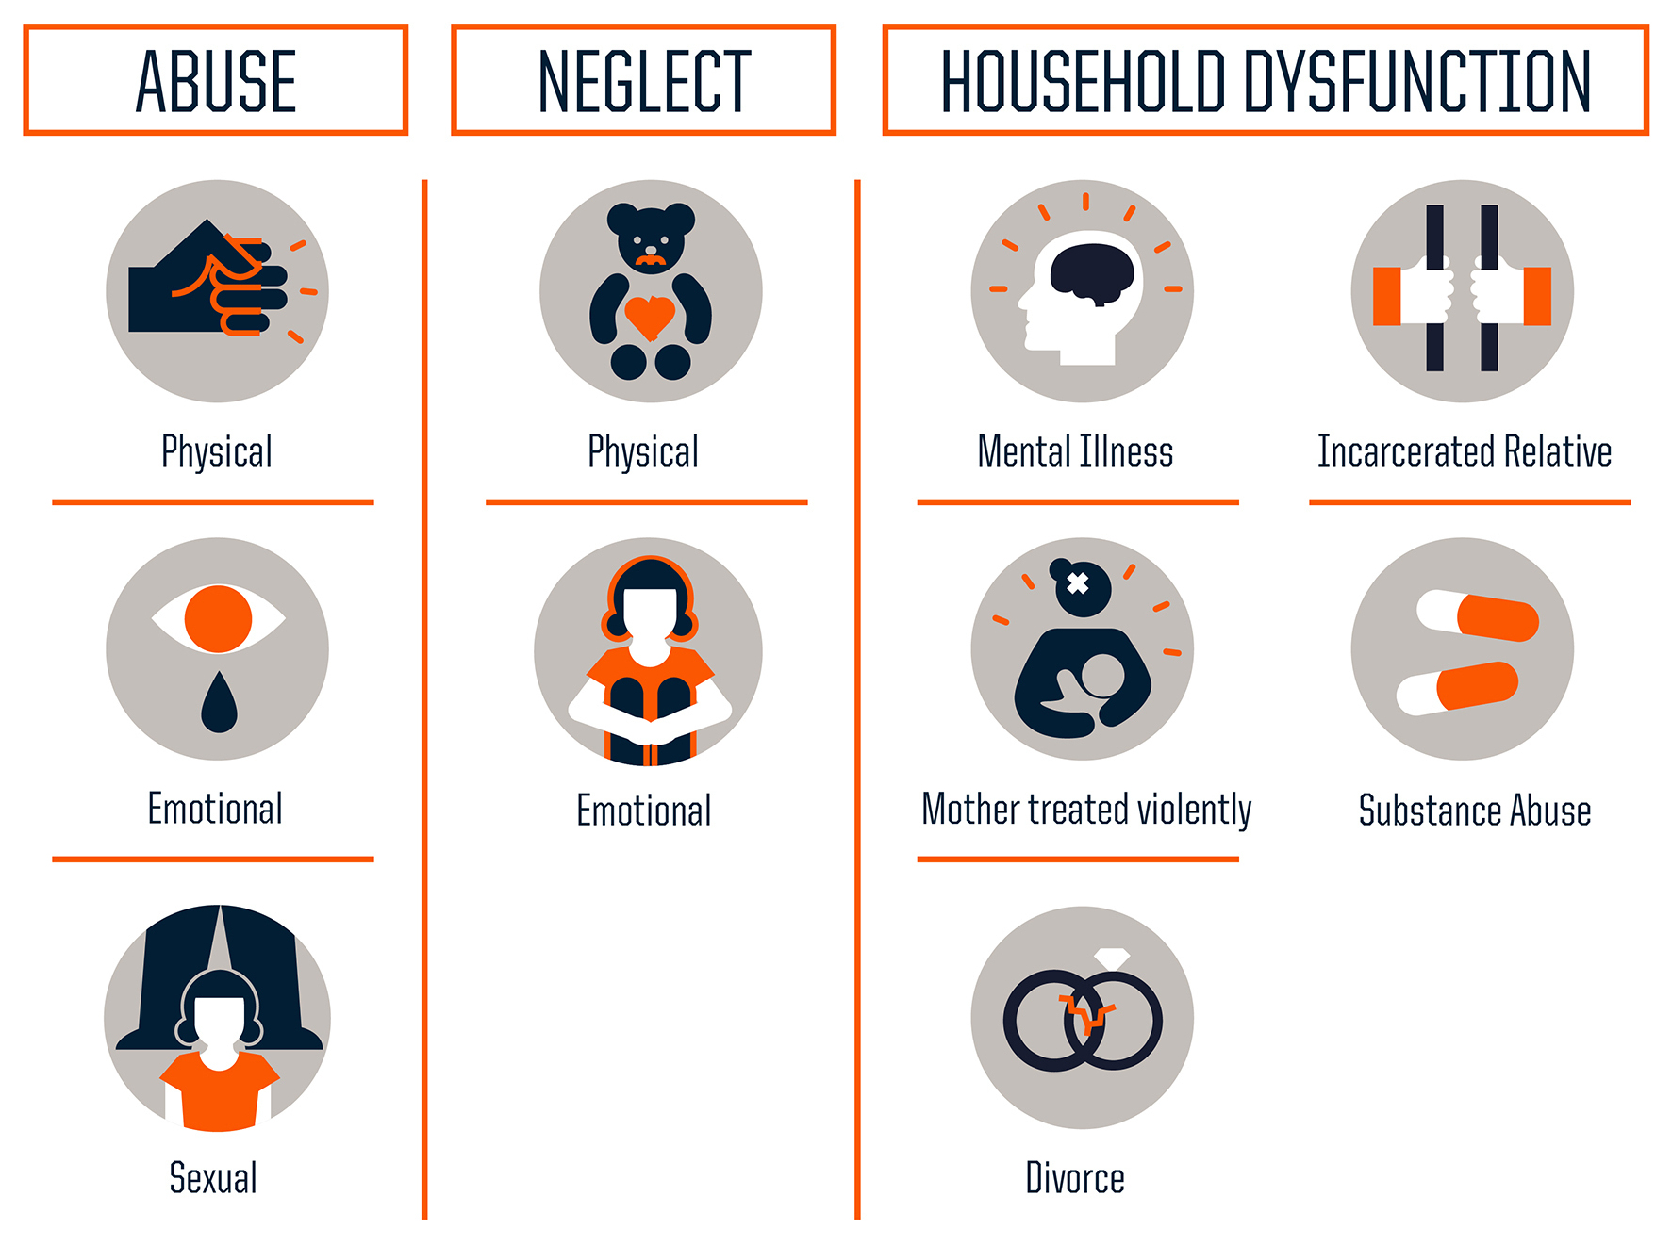
YOUNG PEOPLE ACCESSING ADVICE
Adverse Childhood Experiences
Copyright© 2021. Ask Us is a 1625 Independent People, Citizen Advice Bristol and Bristol Law Centre project

Slide 11
YOUNG PEOPLE ACCESSING ADVICE
What is trauma?
The word trauma is used to describe negative events that are emotionally painful and that overwhelm a person’s ability to cope.
An event which leaves a person feeling terrified and completely helpless, lack of control, unpredictability, loss of safety, fear of serious harm/death
Early childhood trauma has more of an effect on the individual than only experiencing trauma as an adult
Defined by the experience of the individual not the event itself
Copyright© 2021. Ask Us is a 1625 Independent People, Citizen Advice Bristol and Bristol Law Centre project

Slide 12
YOUNG PEOPLE ACCESSING ADVICE
Other Causes
Poverty
Parental mental illness
Exposure to neglect, domestic violence or other forms of abuse
Alcohol/drug taking during pregnancy
Multiple home and school placements
Premature birth
Insecure attachment (anxious, avoidant, and fearful-avoidant)
Abandonment
Family bereavement
Copyright© 2021. Ask Us is a 1625 Independent People, Citizen Advice Bristol and Bristol Law Centre project

Slide 13
YOUNG PEOPLE ACCESSING ADVICE
List of individuals that could experience trauma
Children in areas of social and economic deprivation
Children in care - Adopted children whose early experiences of trauma continue to affect their lives
Children or Children with siblings with medical conditions, illness or disabilities
Children who have moved home frequently during their early years e.g. forces families
Refugees and children who have been traumatised by conflict or loss
Lesbian, gay, bisexual, transgender, and queer or questioning (LGBTQ) youth experience trauma at higher rates than their straight peers.
Child carers/Translating for parents (hearing and discussing financial and personal content)
Copyright© 2021. Ask Us is a 1625 Independent People, Citizen Advice Bristol and Bristol Law Centre project

Slide 14
YOUNG PEOPLE ACCESSING ADVICE
How to support someone who has experienced trauma
Predictability - Everyone loves surprises! Not. Trauma survivors often prefer predictability because that feels safer
Space - Allow time for the survivor to calm down and take perspective. Trauma survivors often have difficulty regulating emotions and take longer to calm down.
Perspective - Be aware when ‘past is intruding into present.’ Don’t take responsibility for what is not yours... gently.
Choice - It can be a big trigger when a survivor is denied choice and control. Confer, collaborate, and cooperate. Empower them- inform them what’s happening.
Reciprocity - Give what you also need to receive: listening, empathy, and empowerment.
Support - Be kind, patient... but empathetically set limits - you have needs too
Language - Rid ‘over-reacting’, ‘over-sensitive’, or ‘over’-anything from your vocabulary
Copyright© 2021. Ask Us is a 1625 Independent People, Citizen Advice Bristol and Bristol Law Centre project

Slide 15
YOUNG PEOPLE ACCESSING ADVICE
Attachment Theory
From birth we learn how to relate to others and the world through our caregiver(s)
This relationship with our caregivers teaches us to understand, process and regulate our own emotions.
If all of the child's emotional and physical needs are met the child will develop a ‘secure’ attachment and is unlikely to have further issues
Copyright© 2021. Ask Us is a 1625 Independent People, Citizen Advice Bristol and Bristol Law Centre project

Slide 16
YOUNG PEOPLE ACCESSING ADVICE
4 R’s for a trauma aware practice
Realise
Recognise
Respond actively
Resist re-traumatisation
Copyright© 2021. Ask Us is a 1625 Independent People, Citizen Advice Bristol and Bristol Law Centre project

Slide 17
YOUNG PEOPLE ACCESSING ADVICE
What could we be doing that could help young people remain engaged with the advice process?
Copyright© 2021. Ask Us is a 1625 Independent People, Citizen Advice Bristol and Bristol Law Centre project

Slide 18
YOUNG PEOPLE ACCESSING ADVICE
Do any of the previous activity statements directly relate to each other?
Copyright© 2021. Ask Us is a 1625 Independent People, Citizen Advice Bristol and Bristol Law Centre project

Slide 19
YOUNG PEOPLE ACCESSING ADVICE
Social Workers
PA’s
Support Workers
Copyright© 2021. Ask Us is a 1625 Independent People, Citizen Advice Bristol and Bristol Law Centre project

Slide 20
YOUNG PEOPLE ACCESSING ADVICE
In the simplest terms, the concept of trauma-informed care is straightforward. If professionals were to pause and consider the role trauma and lingering traumatic stress plays in the lives of the specific client population served by an individual, professional, organization, or an entire system, how would they behave differently? What steps would they take to avoid, or at least minimize, adding new stress or inadvertently reminding their clients of their past traumas? How can they better help their traumatized clients heal? In effect, by looking at how the entire system is organized and services are delivered through a “trauma lens,” what should be done differently?
Wilson, Pence, and Conradi (2013)
Copyright© 2021. Ask Us is a 1625 Independent People, Citizen Advice Bristol and Bristol Law Centre project

