Slide 1



GOOD PRACTICE IN DELIVERING INFORMATION
This resource is part of the Ask Us Advice Toolkit. For more information or queries on any of the topics covered in this toolkit, or to find out about training and consultancy the Ask Us partners can offer please contact enquiries@1625ip.co.uk.
This resource was funded by The National Lottery Community Fund and is offered free for information, educational and professional development purposes. You may not sell this work, nor may it be used as supporting content for any commercial product or service. All copies of this work must clearly display the original copyright notice and Ask Us Toolkit website address. Any on-line reproduction must also provide a link to the Ask Us Toolkit website. Copyright© 2021. Ask Us is a 1625 Independent People, Citizen Advice Bristol and Bristol Law Centre project.
www.askustoolkit.co.uk

Slide 2




ASK US PRESENTATION
GOOD PRACTICE IN DELIVERING INFORMATION

Slide 3
GOOD PRACTICE IN DELIVERING INFORMATION
Session aims
To make support workers aware of good practice in delivering information
To improve information giving skills amongst support workers
To make support workers aware of publicly available information resources

Slide 4
GOOD PRACTICE IN DELIVERING INFORMATION
By the end of this session you will
Be familiar with Ask Us recognised websites and list 5 that a young person presenting in crisis could use
Can identify 3 emergency/crisis situations
Accurately identify key issues and list 5
Know when and how to refer, signpost and provide information to young people in crisis.

Slide 5
GOOD PRACTICE IN DELIVERING INFORMATION
Key issues
Benefits
Employment/Work
Debt and Money
Consumer (Shopping including utilities)
Housing
Family
Law and Courts
Immigration
Health

Slide 6
GOOD PRACTICE IN DELIVERING INFORMATION
Case Study - Emily
What key issues are highlighted in this case study?

Slide 7
GOOD PRACTICE IN DELIVERING INFORMATION
Relationship
Debt
Employment
Benefits
Housing
(Mental) Health

Slide 8
GOOD PRACTICE IN DELIVERING INFORMATION
What has happened?
When?
Is there a deadline?
Is there a risk of losing home/ liberty?

Slide 9
GOOD PRACTICE IN DELIVERING INFORMATION
Emergencies
Consequences
Capacity

Slide 10
GOOD PRACTICE IN DELIVERING INFORMATION
Case study - Amelia

Slide 11
GOOD PRACTICE IN DELIVERING INFORMATION
Don’t advise
Summary
Next step

Slide 12
GOOD PRACTICE IN DELIVERING INFORMATION
What does successful information-giving look like?
The young person understands why they need the information
The young person is able to use the information
The young person understands how the information relates to them
The information is up to date, accurate and relevant

Slide 13
GOOD PRACTICE IN DELIVERING INFORMATION
By looking for information online with the young person you can also support them to develop a range of skills including:
Helping them to understand their rights and responsibilities
Helping them to understand procedures involved in tackling their key issues
Helping them to express their wishes and needs in the process
Help to relieve their anxiety about the process

Slide 14
GOOD PRACTICE IN DELIVERING INFORMATION
What makes an effective signposting?
The client has everything they need to access the service you’ve signposted to. This involves:
  The address for the service (If a physical location)
  Map detailing how to get there
  Contact details (if appropriate)
Online access (If signposting to online services)
Details of where to access online services (library, drop in centre eg.)
You’ve used the most up to date information about the service you’ve signposted to.
The client meets the criteria for the service you’ve signposted to.
The client knows what to ask for when they access the service you’ve signposted them to

Slide 15
GOOD PRACTICE IN DELIVERING INFORMATION
What makes a referral successful?
The organisation you are referring the young person to has all the information they need to work with the individual
The young person understands why they are being referred and what to expect from the process (managing expectations)
The young person feels happy to work with the organisation and/or professional they’ve been referred to
There is an open channel of communication between you as the support worker and the organisation/professional. This helps the young person to feel supported from all sides

Slide 16
GOOD PRACTICE IN DELIVERING INFORMATION
Ask Us Recognised Websites
www.citizensadvice.org.uk
www.bristollawcentre.org.uk
www.1625ip.co.uk
www.gov.uk
www.bristol.gov.uk
www.acas.org.uk
england.shelter.org.uk
www.gingerbread.org.uk
www.nextlinkhousing.co.uk
www.lawstuff.org.uk
www.childlawadvice.org.uk
www.turn2us.org.uk
www.nationaldebtline.org.uk
www.otrbristol.org.uk

Slide 17
GOOD PRACTICE IN DELIVERING INFORMATION
Amelia Case Study
What are 5 websites that you could give to Amelia to help with her situation?
What are the most urgent information issues for Amelia?
What could an action plan look like for Amelia?
What local services could you signpost Amelia to?

Slide 18
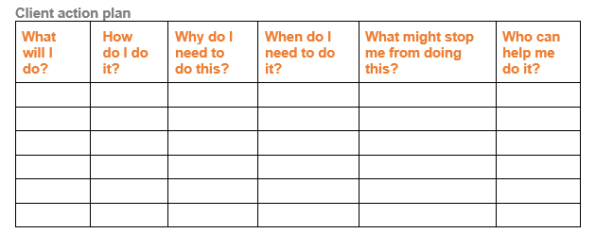
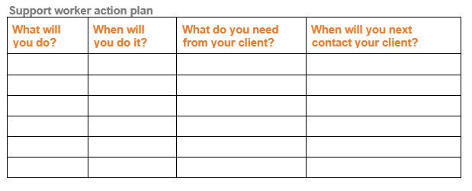
GOOD PRACTICE IN DELIVERING INFORMATION

Slide 19
GOOD PRACTICE IN DELIVERING INFORMATION
Recording your appointment
What was discussed
What was suggested
Information sources
GDPR
Do not record opinions

Slide 20
ASK US PRESENTATION
GOOD PRACTICE IN DELIVERING INFORMATION

